Slide 1
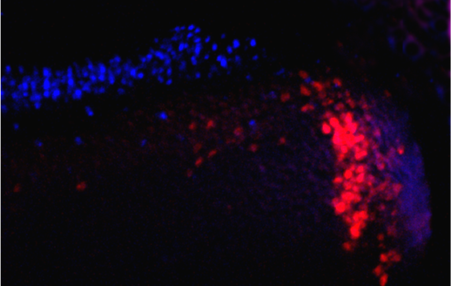
Figure 9
A
XAP-2
Light
B
XAP-2
Darkness
C
XAP-2-BrdU
Darkness
Rods

